Slide 1
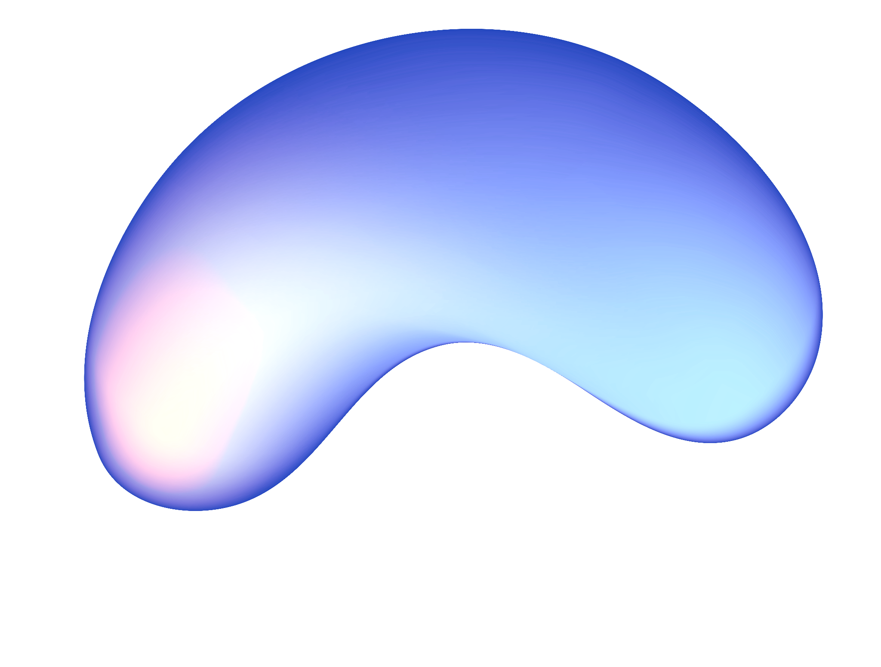
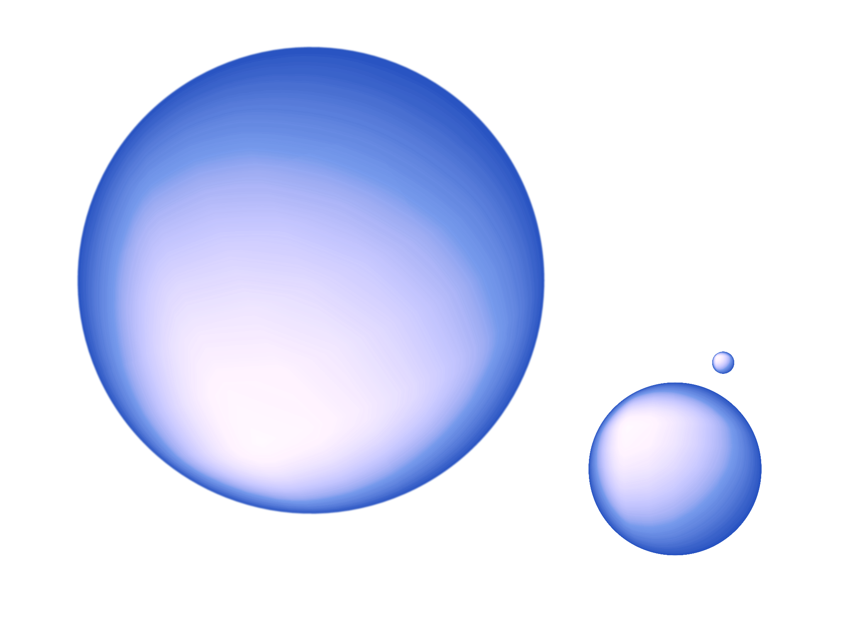
Unlocking the World Through Computer Vision
Gayathri Girish

Slide 2
About me
Master's Student in Applied Computing (AI), University of Toronto
Current Work
Intern at Mount Sinai Hospital
Applying LLMs to extract critical information from MRI reports
Education
B.Tech in Electronics and Communication Engineering, VIT University, Class of 2023
Achievements
Mitacs Globalink Research Award, 2022
Singapore International Pre-Graduate Award (SIPGA), A*STAR, 2023

Slide 3
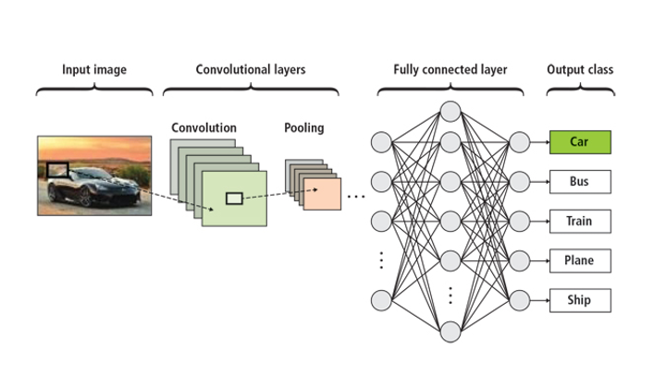
How It Works
Input: Visual data like images or video.
Process: Machine learning models analyze pixel patterns.
Output: Decision or interpretation (e.g., object classification, scene description).

Slide 4
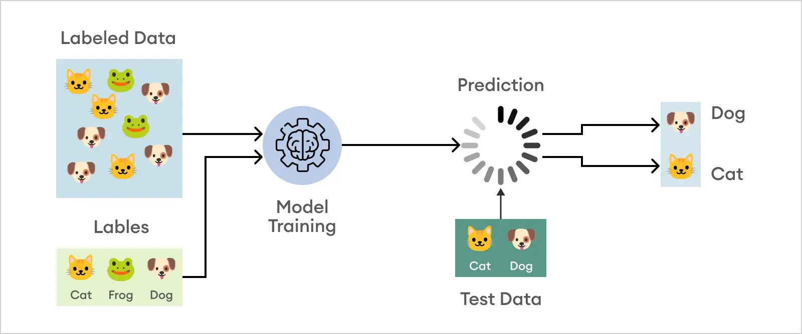
Key Tasks
Image Classification: Identifying objects in images (e.g., cat or dog).
Object Detection: Locating and labeling objects within images.
Segmentation: Dividing an image into meaningful regions.
Image Generation: Creating new images (GANs, etc.).
Notes:
1. Image Classification (1-2 mins)
What it is: Identifying the main object in an image and assigning it a label.
Example: Classifying whether an image contains a cat or a dog.
How it's done: Mention how convolutional neural networks (CNNs) learn from labeled data.
Real-world use: Used in organizing photo libraries (e.g., Google Photos automatically labeling dogs).
2. Object Detection (1-2 mins)
What it is: Not just identifying objects but also locating them in the image (bounding boxes).
Example: Detecting pedestrians in a self-driving car's camera feed.
How it's done: Use of models like YOLO (You Only Look Once) that perform detection in real-time.
Real-world use: Security cameras using detection to monitor intruders or face detection for unlocking phones.
3. Segmentation (1-2 mins)
What it is: Dividing an image into regions based on the content (pixel-level classification).
Example: In medical imaging, segmenting tumors in MRI scans.
How it's done: Use of models like UNet, which handle medical image segmentation.
Real-world use: Critical in healthcare for identifying and diagnosing diseases.
4. Image Generation (1-2 mins)
What it is: Generating realistic new images using models like Generative Adversarial Networks (GANs).
Example: GANs generating lifelike portraits of non-existent people (e.g., ThisPersonDoesNotExist.com).
How it's done: Two networks (generator and discriminator) work against each other to produce convincing images.
Real-world use: Used in art, deepfake generation, and enhancing low-resolution images.
Self-driving car using all these tasks: classifying road signs, detecting pedestrians, segmenting lanes, and generating realistic training data.

Slide 5
Popular Computer Vision Models

Slide 6
Convolutional Neural Networks (CNNs): Great for image classification and detection.
Generative Adversarial Networks (GANs): Used for creating synthetic images.
YOLO (You Only Look Once): Real-time object detection.
UNet: Used for medical image segmentation.

Slide 7
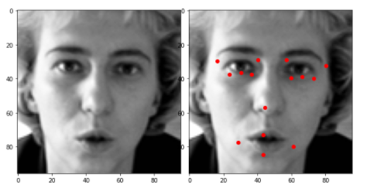
Convolutional Neural Networks (CNNs)
CNNs are designed to learn spatial hierarchies of features.
Key layers: Convolutional layers, Pooling layers, and Fully Connected layers.
CNNs detect patterns like edges, shapes, and objects as layers progress.
Example: ImageNet classification (1,000 different objects).
Applications: Facial recognition, object detection, autonomous vehicles.
Real-world use: Google Photos, Instagram filters.

Slide 8
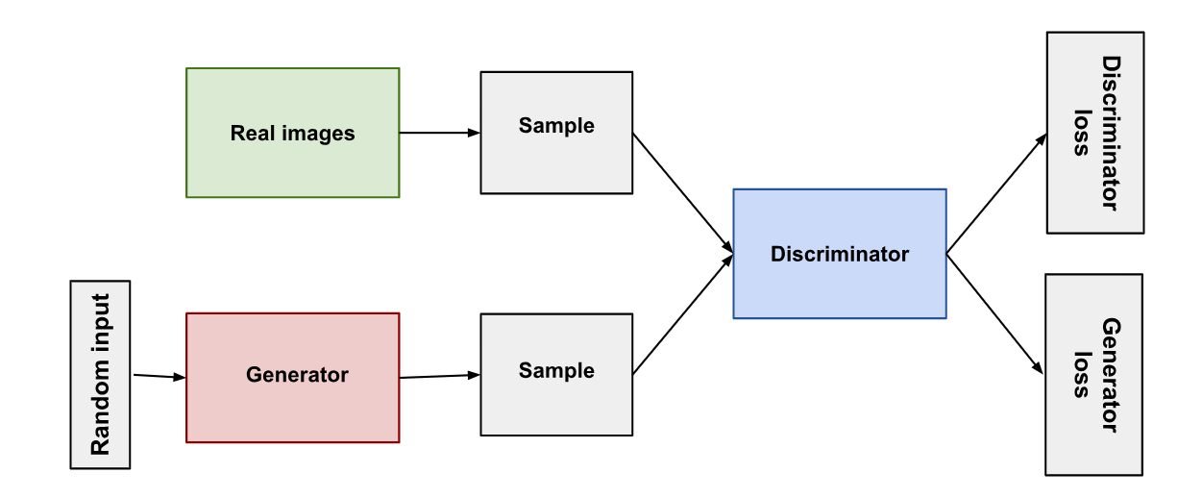
Generative Adversarial Networks (GANs)
GANs have two networks: Generator and Discriminator.
Generator creates fake images; Discriminator tries to detect fake images.
Over time, the generator improves at creating realistic images.
Example: GANs generate synthetic images (e.g., deepfakes or realistic faces).

Slide 9
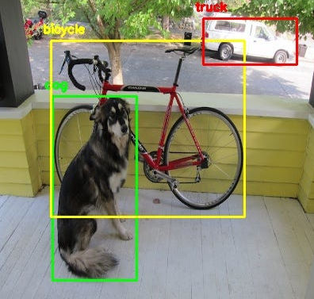
YOLO (You Only Look Once)
YOLO is an efficient, real-time object detection model.
Processes images in one pass, ideal for speed.
YOLO divides the image into grids and predicts bounding boxes and class probabilities.
Example: Detecting people, cars, and objects in video streams.
Applications: Security systems, autonomous vehicles, drones.
Real-world use: Real-time object detection in autonomous vehicles or surveillance.

Slide 10
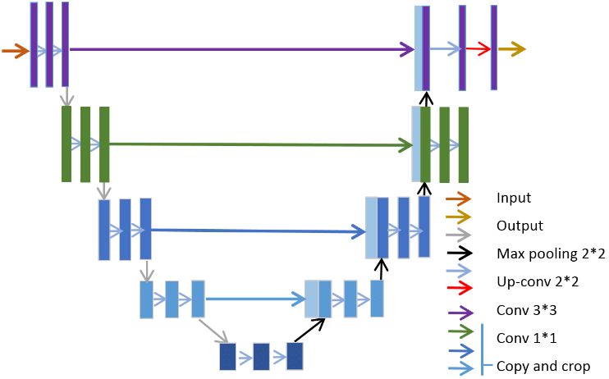
UNet
UNet is a convolutional neural network used for precise image segmentation.
U-shaped architecture with an encoder-decoder structure.
Example: Segmenting tumors in medical images or satellite image regions.
Applications: Healthcare (organ segmentation), environmental monitoring.
Real-world use: Tumor segmentation in medical scans for diagnosis.

Slide 11
Applications

Slide 12
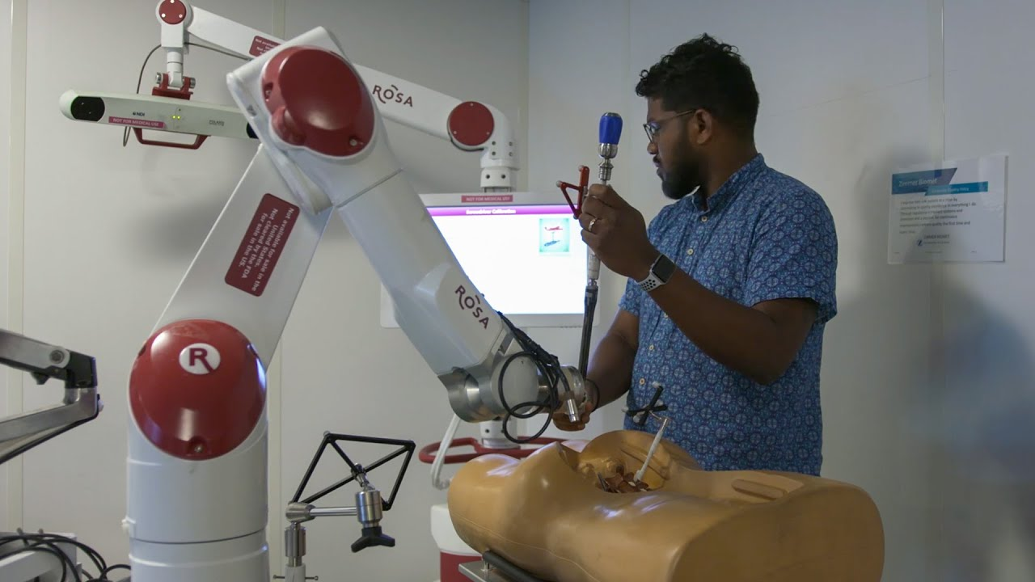
Applications in Healthcare
Medical Imaging: Identifying tumors, diagnosing diseases.
Surgical Assistance: Real-time monitoring during operations.
Healthcare Robotics: Vision-guided robots for surgeries.

Slide 13
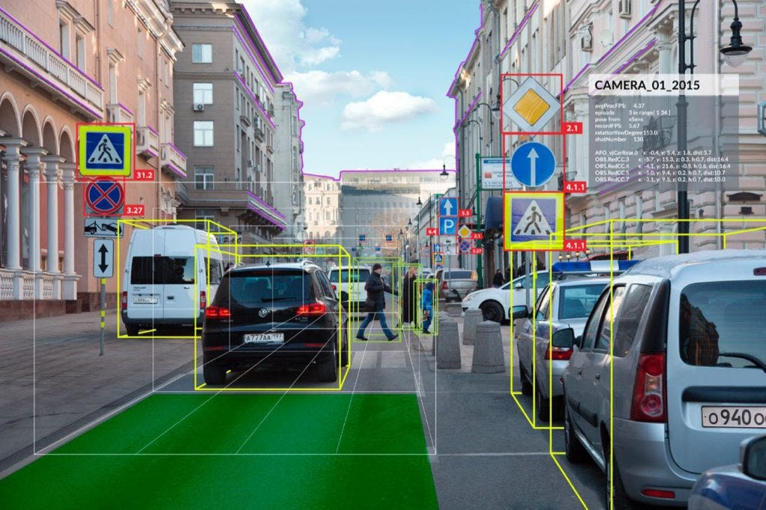
In Autonomous Vehicles
Lane Detection: Identifying road boundaries.
Object Detection: Recognizing other cars, pedestrians.
Real-time decision-making: Assisting in navigation.

Slide 14
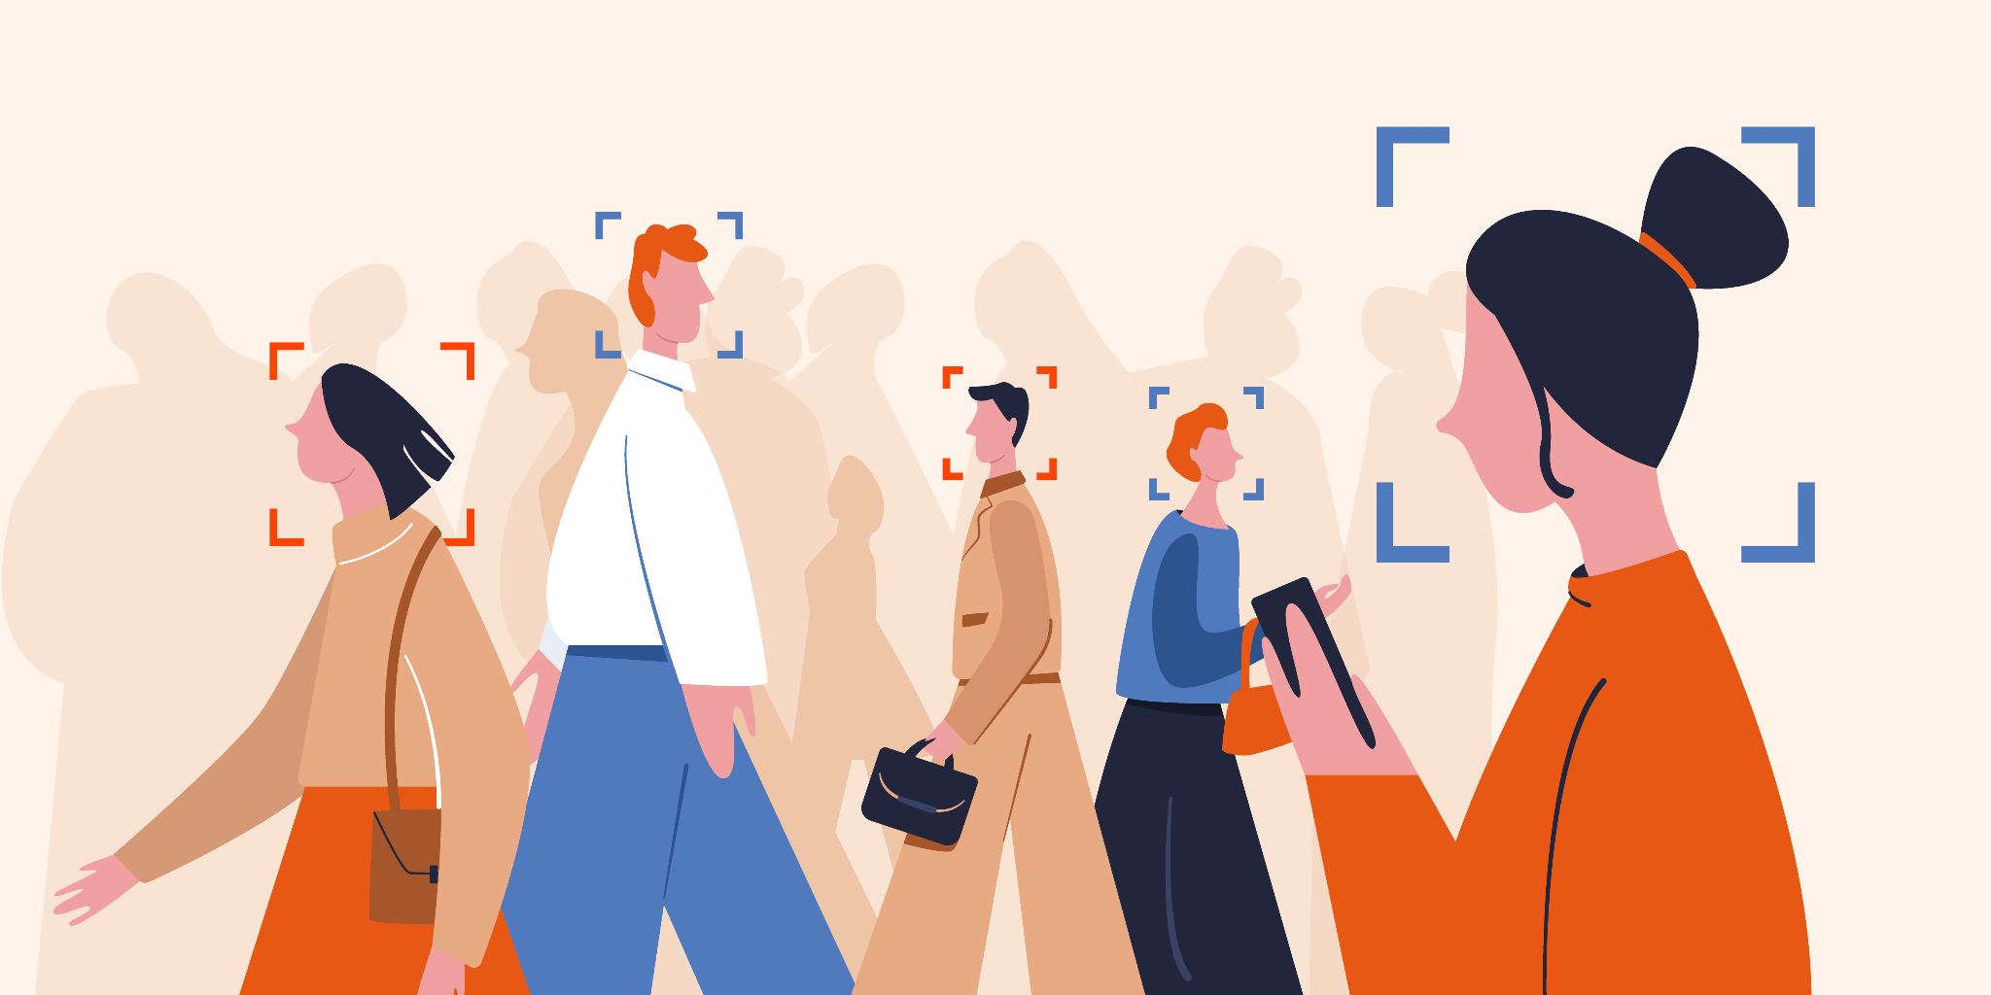
Facial Recognition and Security
Face Detection: Identifying faces in images or video.
Recognition: Verifying identities (used in phones, security systems).
Ethical concerns: Privacy and surveillance issues.

Slide 15
Challenges and Future

Slide 16
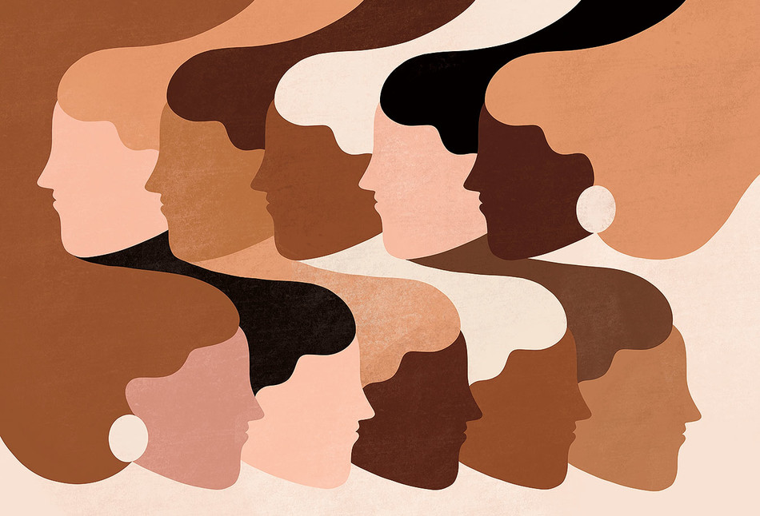
Challenges in Computer Vision
Dataset Quality: Bias in data can affect model accuracy.
Real-Time Processing: High computational demand for real-time tasks.
Ethical Issues: Surveillance and privacy concerns.

Slide 17
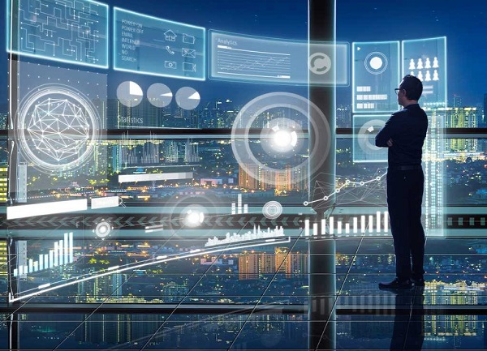
The Future of Computer Vision
Real-time enhancements in AR/VR.
Advancements in healthcare (e.g., AI-assisted surgeries).
Ethical frameworks for responsible AI use.

Slide 18
Thank you!

